Slide 1

Social Science Research Design and Statistics, 2/e Alfred P. Rovai, Jason D. Baker, and Michael K. Ponton
Factor Analysis
PowerPoint Prepared by Alfred P. Rovai
IBM® SPSS® Screen Prints Courtesy of International Business Machines Corporation,
© International Business Machines Corporation.

Slide 2
Uses of Factor Analysis
Factor analysis is a parametric procedure used to analyze interrelationships among a large number of variables and to explain these variables in terms of their common underlying dimensions (i.e., factors or components).
Factor analysis addresses two types of variables:
Observed variables.
Latent variables (i.e., underlying factors that are relatively independent of one another).

Slide 3
Uses of Factor Analysis
The issue of whether factor structures should be theory-based or data-based depends on whether the analysis is confirmatory or exploratory.
Exploratory factor analysis (EFA) seeks to uncover the underlying structure of a relatively large set of variables. The researcher's à priori assumption is that any indicator may be associated with any factor. This is the most common form of factor analysis. There is no prior theory and one uses factor loadings to discern the factor structure of the data.
Confirmatory factor analysis (CFA) seeks to determine if the number of factors and the loadings of observed variables on them conform to what is expected on the basis of pre-established theory. A minimum requirement of CFA is that one hypothesize beforehand the number of factors in the model.

Slide 4
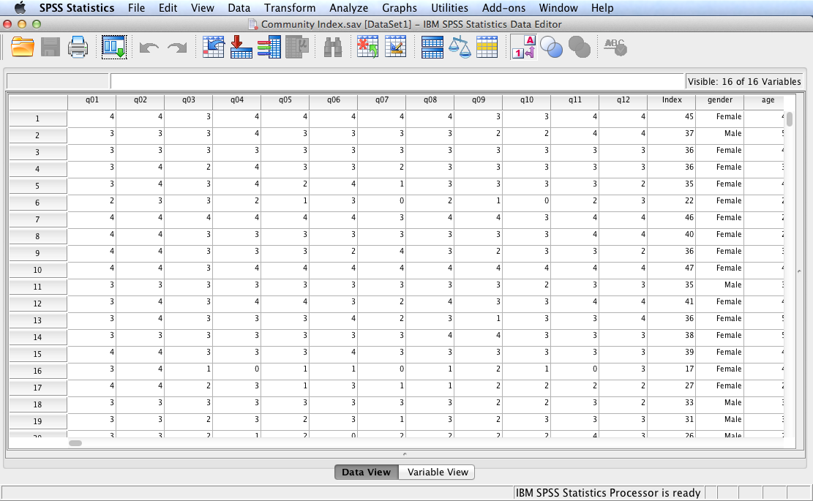
Open the dataset Community Index.sav.
File available at http://www.watertreepress.com/stats

Slide 5
Sense of Classroom Community Index
Factor analysis of the following instrument is conducted in this presentation:
Each item has the following response set: Strongly Agree (SA), Agree (A), Neutral (N), Disagree (D), Strongly Disagree (SD)
I feel that students in this course care about each other
I feel that I am encouraged to ask questions
I feel connected to others in this course
I feel that it is hard to get help when I have a question
I do not feel a spirit of community
I feel that I receive timely feedback
I feel that this course is like a family
I feel isolated in this course
I feel that I can rely on others in this course
I feel uncertain about others in this course
I feel that my educational needs are not being met
I feel confident that others will support me
Items are scored as follows: SA = 4, A = 3, N = 2, D = 1, SD = 0. To obtain the overall Classroom Community Index score, one must add the weights of all 12 items. Total raw scores range from a maximum of 48 to a minimum of 0. Items 4, 5, 8, 10, and 11 are reversed scored.

Slide 6
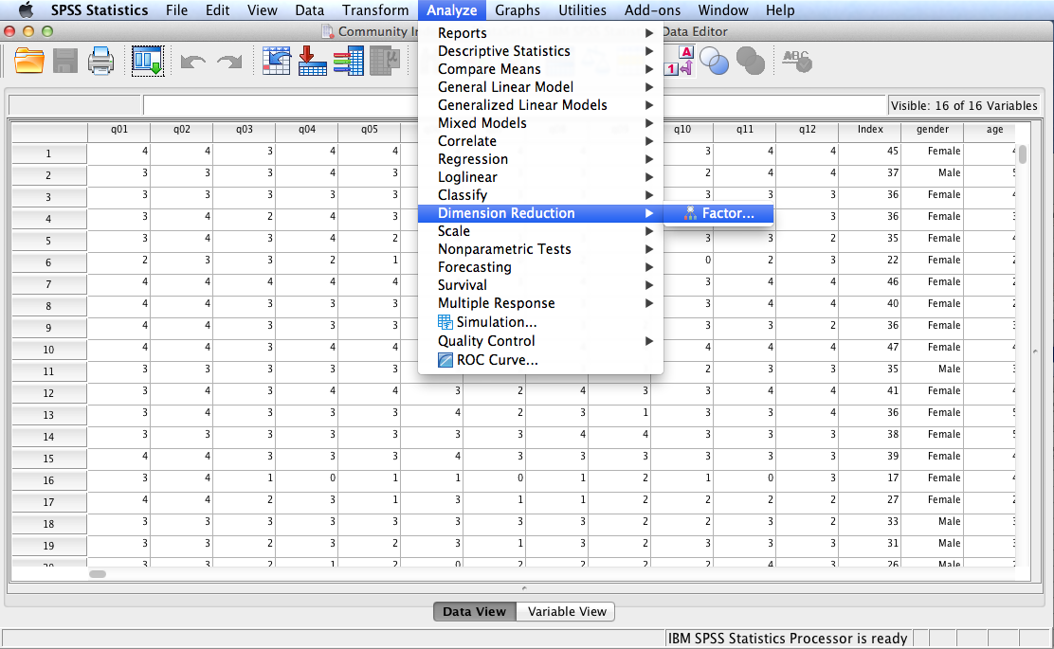
Follow the menu as indicated.

Slide 7
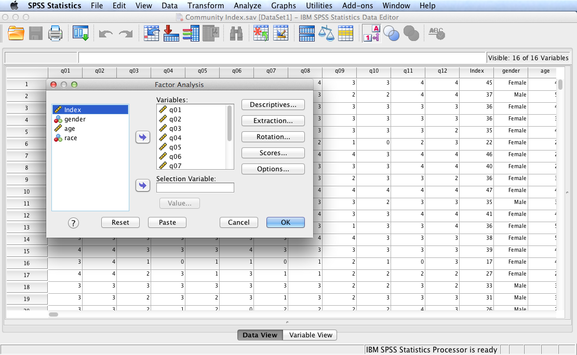
Select and move variables q01 through q12 to the Variables: box. In this example we will test the following null hypothesis:
H₀: The proposed sense of classroom community index is unidimensional.
Click Descriptives…

Slide 8
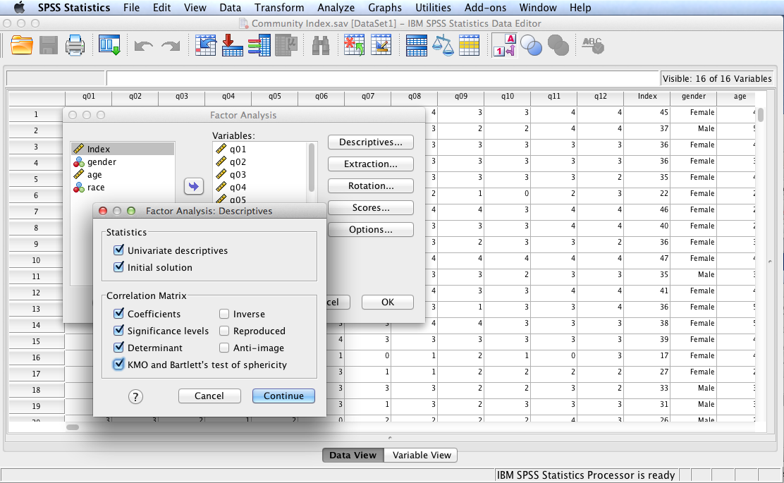
Select the options shown in the Factor Analysis: Descriptives dialog to the left. Click Continue then Extraction.

Slide 9
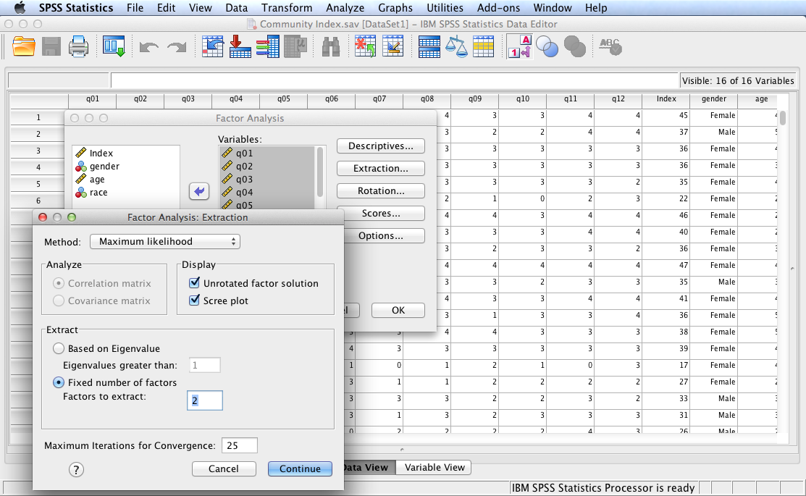
Select the options shown in the Factor Analysis: Extraction dialog to the left. Click Continue then Rotation.
Note: a Confirmatory Factor Analysis (CFA) will be conducted in order to confirm theory that suggests sense of classroom community is composed of two dimensions: social community and learning community.

Slide 10
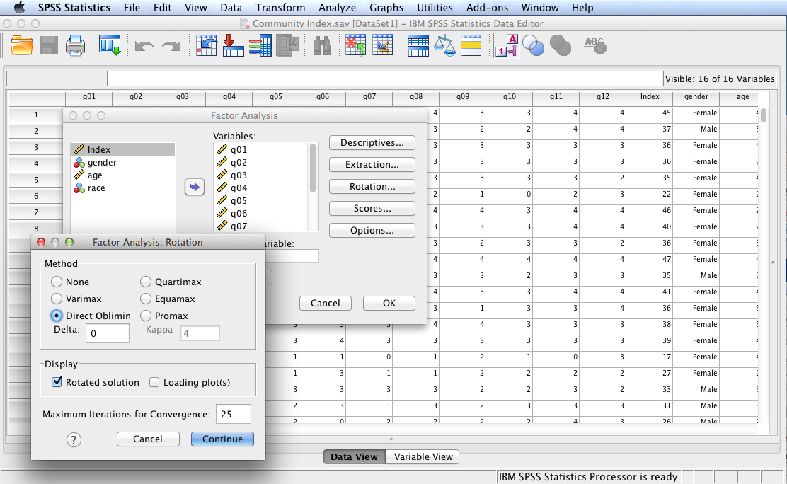
Select the options shown in the Factor Analysis: Rotation dialog to the left. Click Continue then OK.
Note: Direct Oblimin rotation method is selected because it allows for correlations between extracted factors (i.e., it is an oblique method of rotation).

Slide 11
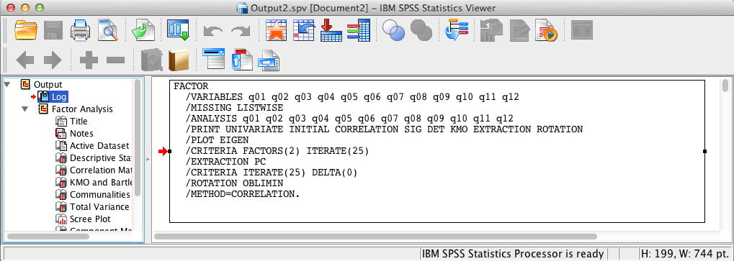
SPSS Output
The contents of the SPSS Log is the first output entry. The Log reflects the syntax used by SPSS to generate the Factor Analysis output.

Slide 12
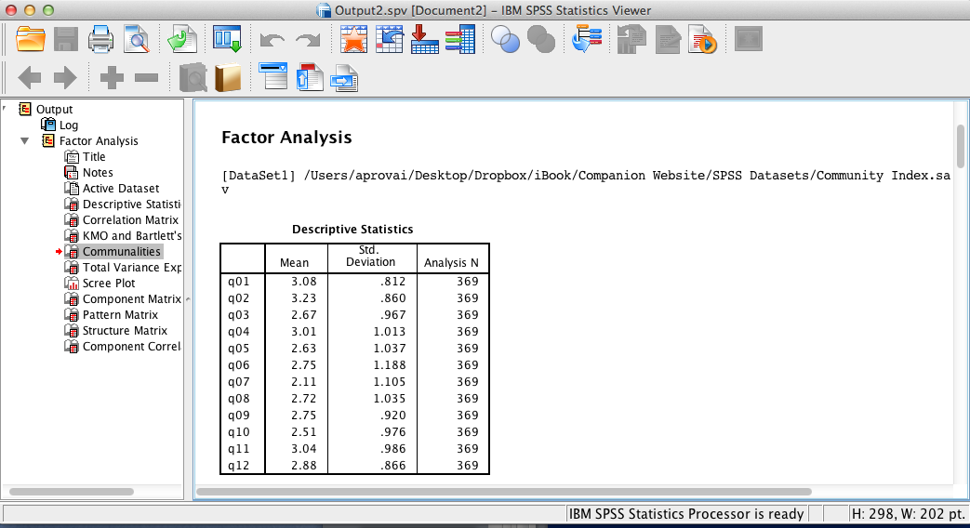
SPSS Output
SPSS output includes descriptive statistics for each variable (i.e., for each item on the Sense of Classroom Community Index).

Slide 13
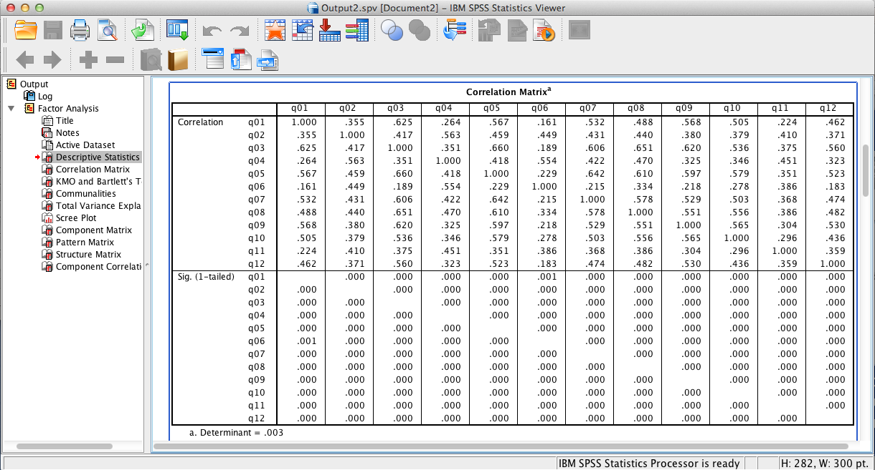
SPSS Output
The above correlation matrix reveals that each variable is related to every other variable, p < .001. Strength of relationships vary between very weak to moderate.

Slide 14
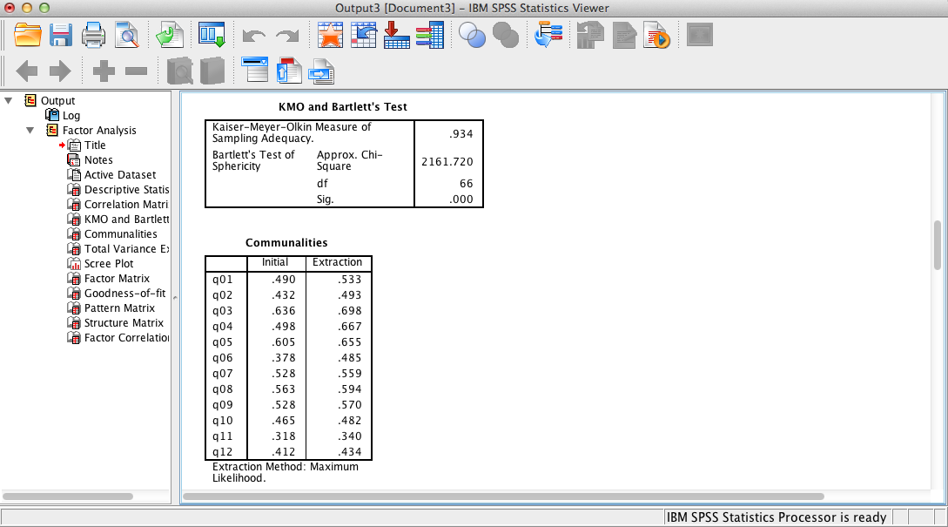
SPSS Output
KMO and Bartlett’s test results show that the data will factor well since the Kaiser-Meyer-Olkin measure is > .9. Also, Bartlett’s test results, p < .05, supports the assumption of sphericity.
Communalities (h²) measure the percent of variance in a given variable explained by all the factors. The output to the left shows that 69.8% of the variance in question 3 is explained by the two factors that were extracted, while only 34% of the variance in question 11 is explained. What one desires are high values for each question.

Slide 15
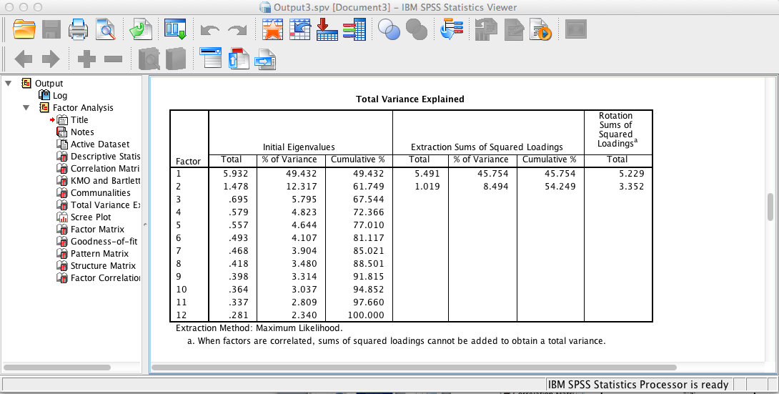
SPSS Output
The above SPSS output shows that the two extracted factors altogether account for 54.25% of the total variance (the first factor accounts for 45.75% and the second factor adds another 8.49%).

Slide 16
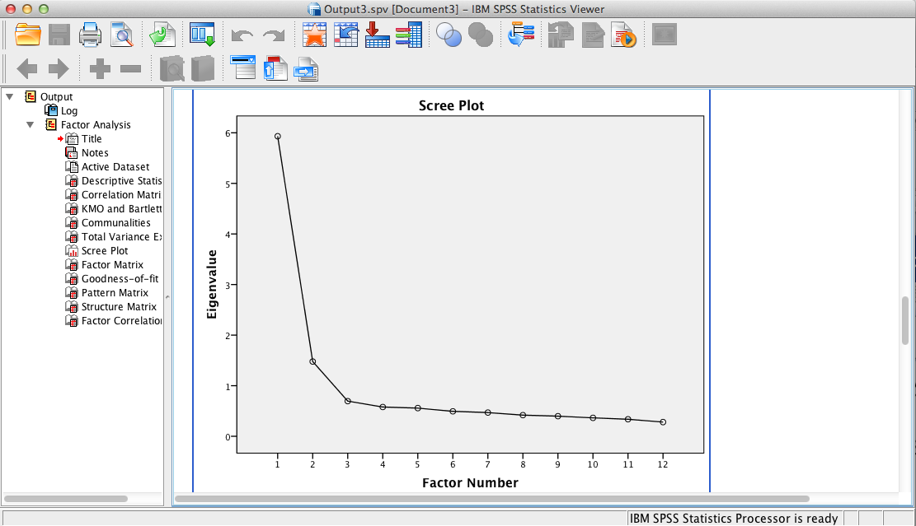
SPSS Output
The scree plot supports a two factor solution since two factors possess eigenvalues of 1.0 or greater.

Slide 17
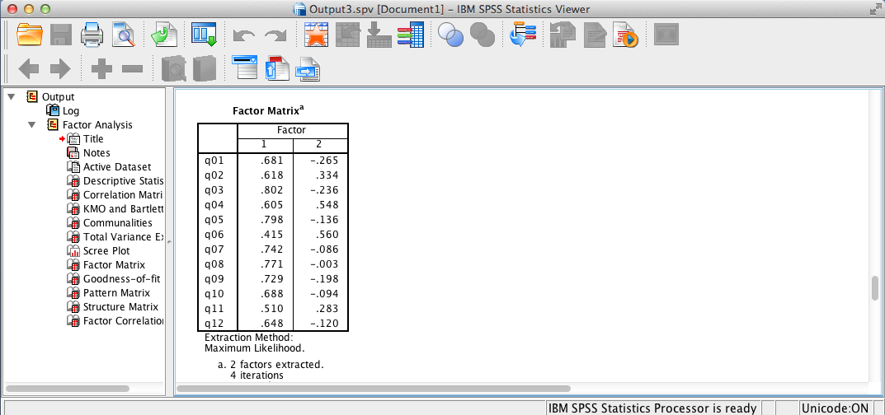
SPSS Output
The factor matrix shows the unrotated factor loadings. Factor loading is interpreted as the Pearson correlation between the variable and the factor.

Slide 18
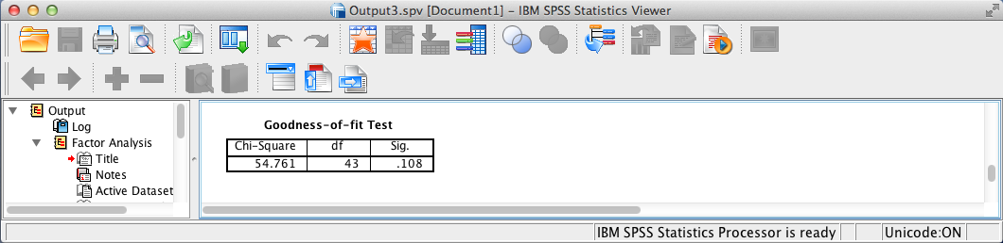
SPSS Output
This test assesses whether the data adequately fits the model. The null hypothesis is that the factor model adequately describes the data.
The above SPSS output provides evidence that the data analyzed adequately fit the model since p > .05. One concludes that the relationships among the variables are adequately described by the two factor model.

Slide 19
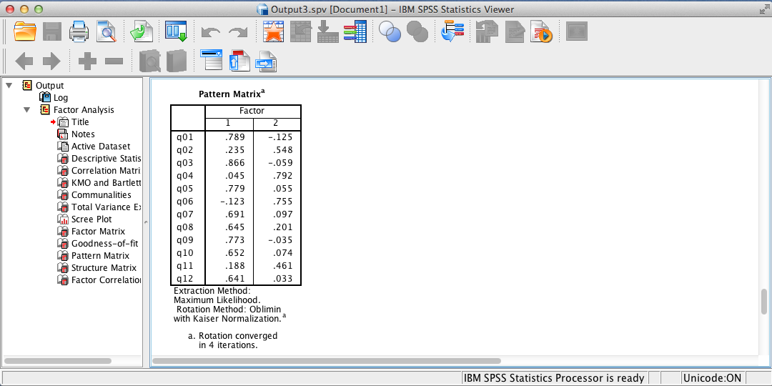
SPSS Output
The model presented looks good because simple structure is achieved as each variable loads unambiguously onto one and only one factor using .30 as a cutoff. Cross-loadings are relatively small. This provides for a clean, simple interpretation of the data.
An examination of the observed variables that load onto each factor allows one to label the factors and view them as subscales (dimensions) of the instrument. In the case of the tested instrument, “Factor 1” can be labeled as classroom social community and “Factor 2” can be labeled classroom learning community.

Slide 20

SPSS Output
The pattern matrix and the structure matrix are equal after orthogonal rotation and unequal after oblique rotation (the case here because of Direct Oblimin rotation). However, only the pattern matrix (the previous output) need be examined since it allows for the easiest interpretation of factors.

Slide 21
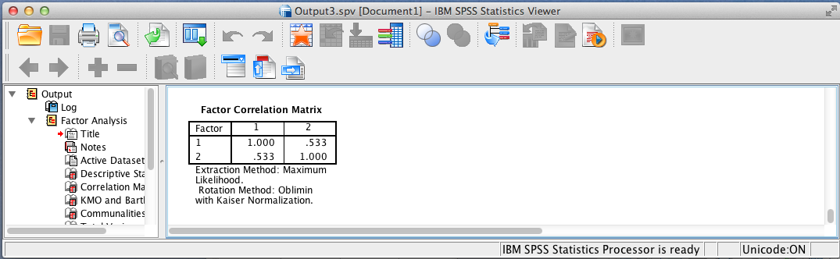
SPSS Output
The above SPSS output shows a moderate relationship between the two extracted factors.
Note: very high correlations between pairs of factors suggest such factors should be combined into a single factor.

Slide 22
Factor Analysis Results Summary
H₀: The proposed sense of classroom community index is unidimensional.
The factor analysis solution supported the rejection of the null hypothesis that the index is unidimensional and verified a two dimensional solution, as hypothesized, since two factors possessed eigenvalues of 1.00 or greater. The goodness-of-fit test provides evidence that the data adequately fit the model since the test is not significant, p = .11. Overall, the two maximum likelihood factors accounted for a substantial 54.25% of the variance in the data. Additionally, communalities were satisfactory. They reveal that 69.8% of the variance in question 3 was explained by the two factors that were extracted (the item with the highest communality), while only 34% of the variance in question 11 was explained (the item with the lowest communality). An examination of the pattern coefficients suggested that the two-factor solution has good simple structure and can be meaningfully interpreted as classroom social community and classroom learning community. All items have salient loadings on the expected factor.

Slide 23
End of Presentation

